Slide 1
Automation and Control Laboratory
Inverted Pendulum Control
FRANCESCO CERESETTI - ALESSANDRO COLOMBO – GIACOMO DELCARO – PAOLO FUSCO

Slide 2
System Description
Text here
wagergwg

Slide 3
MODEL
EQUATIONS

Slide 4
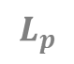
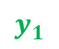
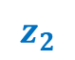
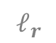
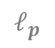

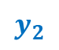

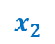
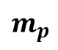

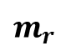
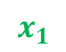
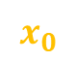


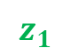
$$L_{r}$$
$$z_{1}$$
$$ℓ_{r}$$
$$m_{r}$$
$$z_{0}$$
$$x_{1}$$
ROD
$$y_{1}$$
$$ℓ_{p}$$
$$θ$$
$$y_{0}$$
$$L_{p}$$
$$x_{0}$$
$$m_{p}$$
PENDULUM
$$α$$
$$x_{2}$$
$$y_{2}$$
$$z_{2}$$

Slide 5
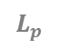
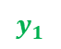
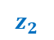
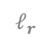
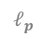

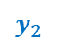

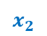
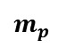
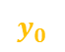
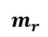
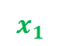
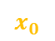


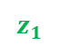
$$L_{r}$$
$$z_{1}$$
$$ℓ_{r}$$
$$m_{r}$$
$$x_{1}$$
$$z_{0}$$
ROD
$$θ$$
$$y_{1}$$
$$ℓ_{p}$$
$$y_{0}$$
$$L_{p}$$
$$x_{0}$$
PENDULUM
$$m_{p}$$
$$α$$
$$x_{2}$$
$$y_{2}$$
$$z_{2}$$

Slide 6
SYSTEM IDENTIFICATION

Slide 7
SIMULATOR
DESIGN

Slide 8
CONTROLLER
DESIGN

